Slide 1
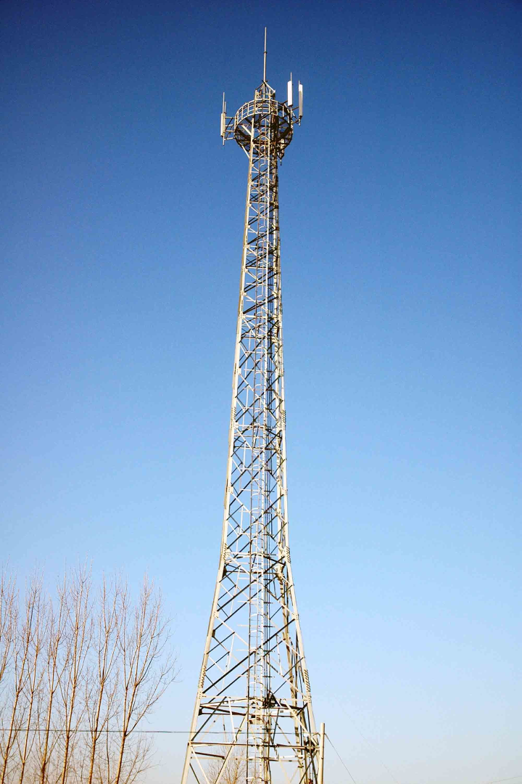

SyriaTel Customer Churn
In the telecom industry, reducing customer churn is crucial for long-term success. This presentation examines SyriaTel's customer churn rate and explores strategies to address this issue.
RK
by Rowlandson Kariuki

Slide 2

Customer Churn Definition
Customer churn refers to the rate at which customers switch from one service provider to another. In the telecom industry, reducing churn is essential for maintaining a loyal customer base and maximizing revenue.

Slide 3
SyriaTel Customer Churn Overview
Brief Background
Current Churn Rate
Impact on Business
SyriaTel is a leading telecom company operating , offering a wide range of services to its customers.
SyriaTel's current churn rate stands at 14.49%, indicating a significant loss of customers over a given period.
High customer churn negatively affects SyriaTel's revenue, market share, and overall profitability.

Slide 4
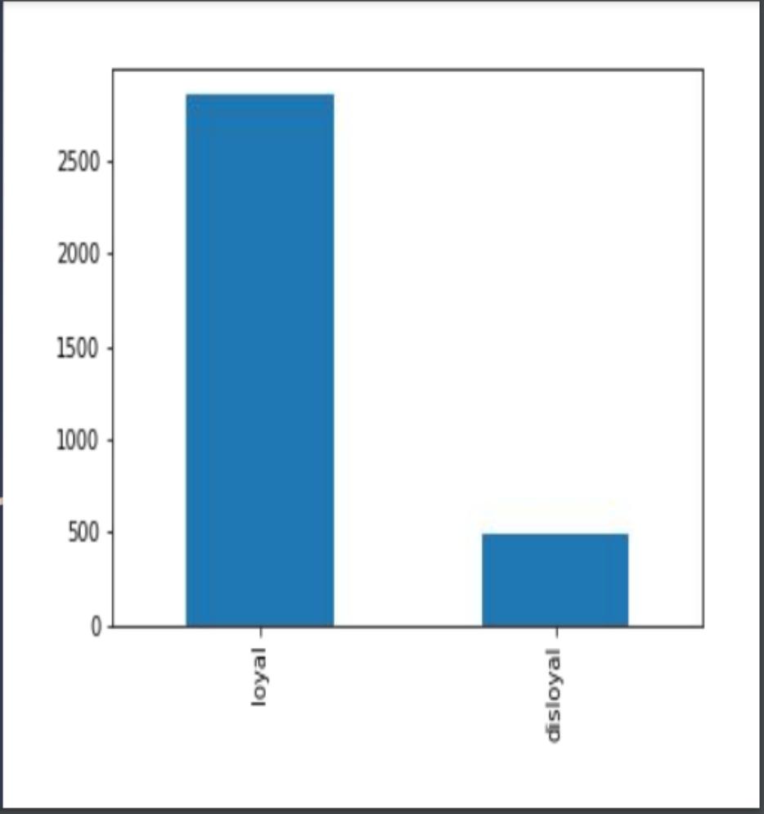
customers churning according to dataset

Slide 5
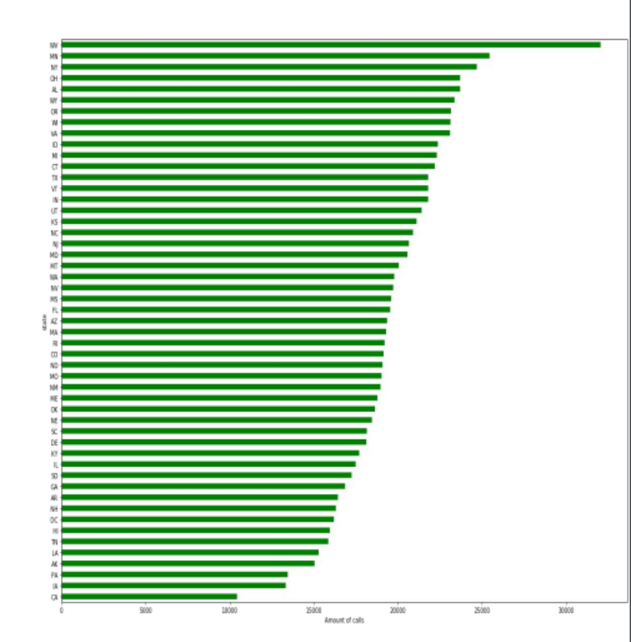
Number of calls per state

Slide 6
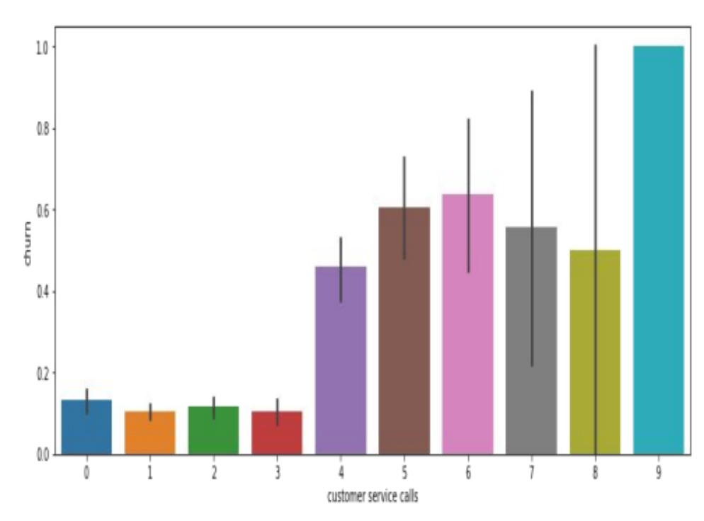
Customers churning based on customer service calls

Slide 7
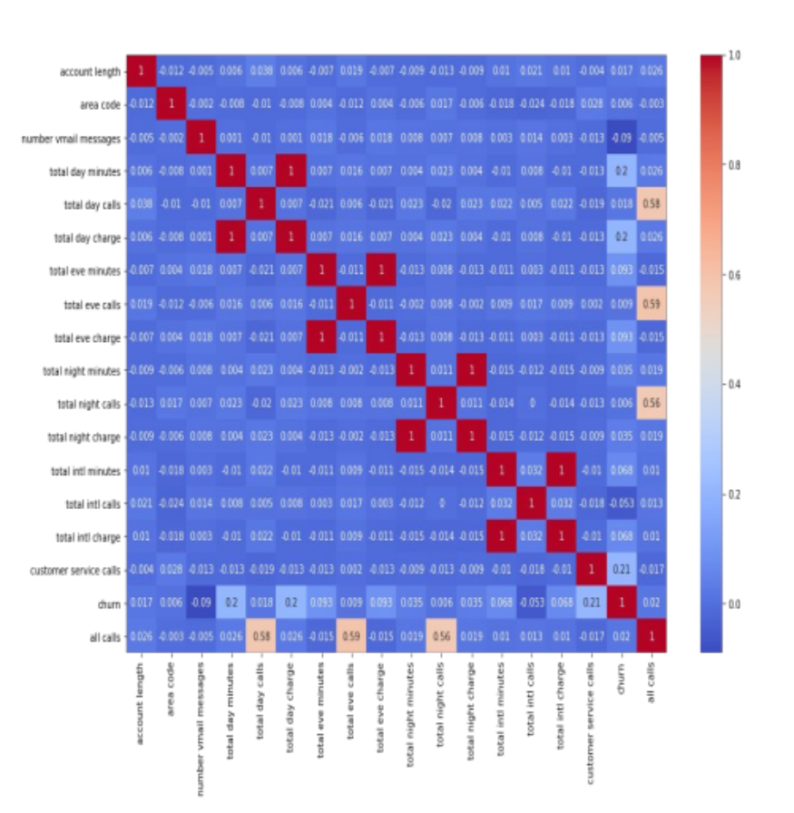
Total day charge, customer service calls, and total day charge/day plan

Slide 8

Factors Contributing to Customer Churn
1
Pricing and Plans
2
Network Quality and Coverage
Uncompetitive pricing and lack of attractive plans are major reasons for customers switching to other providers.
Poor network quality or limited coverage areas lead to customer dissatisfaction and churn.
3
Customer Service and Support
4
Competitors' Offerings
Rival telecom companies offering better deals and services entice SyriaTel's customers to switch.
Inadequate customer service and lack of prompt support contribute to customer frustration and eventual churn.

Slide 9
Strategies to Reduce Customer Churn
1
Improving Pricing and Plans
Revise pricing models and introduce compelling plans to provide customers with better value for their money.
Enhancing Network Quality and Coverage
2
Invest in infrastructure upgrades to ensure reliable and widespread coverage, minimizing network-related customer grievances.
3
Enhancing Customer Service and Support
Implement efficient customer support systems and personalized service experiences to increase customer satisfaction and loyalty.
Analyzing and Responding to Competitors' Offerings
4
Monitor competitors' strategies and offerings to identify areas for improvement and proactively address market demands.

Slide 10

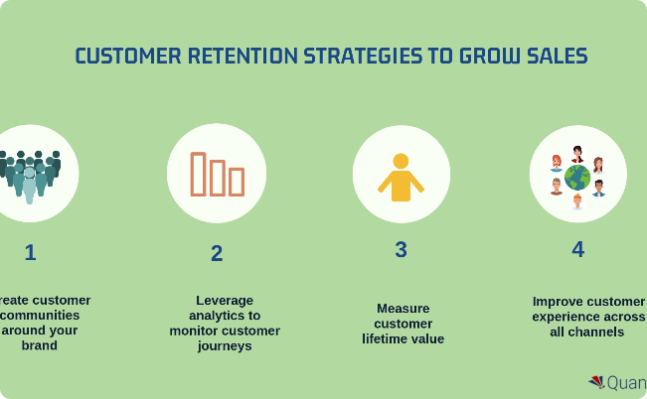
Case Studies of Successful Churn Reduction
Analysis of Strategies
Effective Tactics
Analyze and learn from successful strategies implemented by other telecom companies to mitigate churn and retain customers.
Explore examples of tactics such as loyalty programs, personalized offers, and targeted marketing campaigns that successfully retain customers.

Slide 11
Conclusion
1
Recap of Customer Churn
2
Importance of Implementing Strategies
In the telecom industry, customer churn refers to the rate at which customers switch to a competitor's service. High customer churn poses significant challenges for SyriaTel's business growth and sustainability.
By implementing targeted strategies to reduce churn, SyriaTel can protect its customer base and improve its market position. This is especially important given the competitive nature of the telecom industry.
3
Potential Benefits
4
Call to Action
Reduced churn can lead to increased customer loyalty, higher revenues, and improved brand reputation for SyriaTel. Focusing on churn reduction can help SyriaTel achieve its long-term business goals.
It is essential for SyriaTel to take proactive measures to address customer churn and ensure long-term success in the telecom industry. By implementing the strategies outlined in this deck, SyriaTel can effectively reduce churn and improve its business outcomes.

